Slide 1
Final Project
Group Number – 20
Group Members- Sourabh Kenjale and Jordan Hundt

Slide 2
Outline
Application Description
Implementation
Demonstration
Evaluation and Testing
Conclusion

Slide 3
Application Description
Our website Hotel Reviews at Traveliers.com is a hotel reviews site where users can search for hotels, search for hotel information, search for reviews given to a specific hotel, add a review to a hotel that they have visited and find tags associated with a hotel. The application works quite simple: there is a main home page and there are relevant buttons that take you to the next step where you can enter information in order to get what you desire.
For Ex: there is a button called search reviews on clicking which you get transported to a new site that asks you for the hotel name and the type of review (good, bad or all kinds) you wish to get the reviews on.

Slide 4
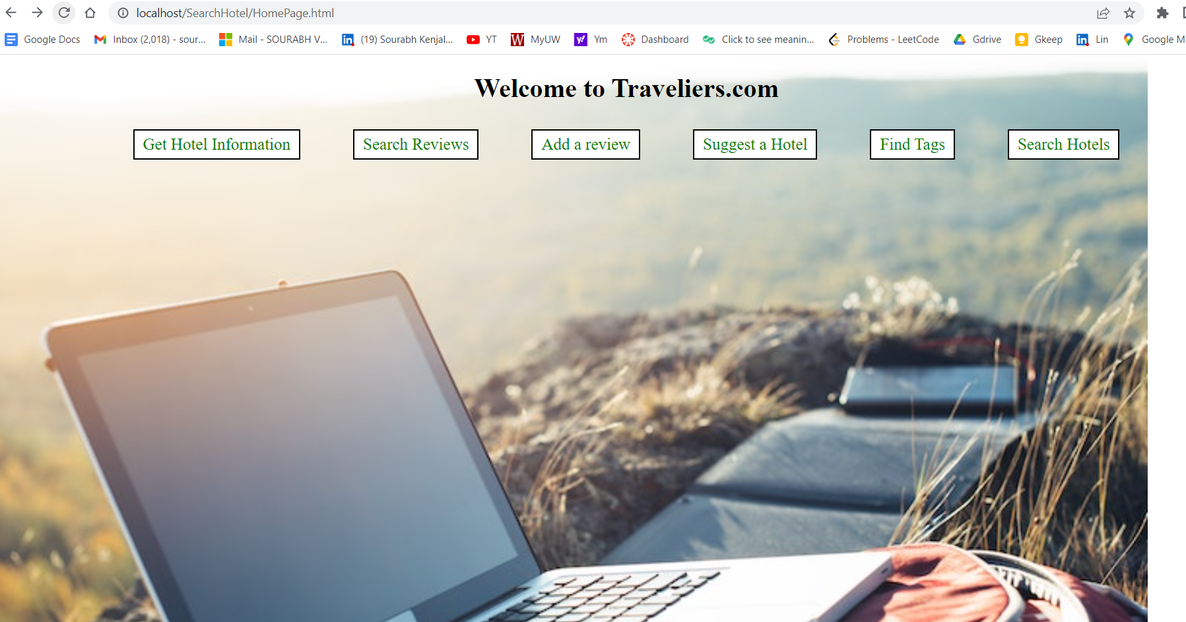
Snapshot of our front page

Slide 5
Domain and Type
Application Domain – Hotel Review site for hotels around Europe
While booking hotels and going on a vacation, we always check for hotel reviews around different websites to see if the hotel is a good place to stay or not. More and more people have started going outdoors and on vacations as the Corona virus pandemic starts to fade. Hotel review websites have become so common place that they are now an integral part of the hospitality industry. Millions of people check hotel review websites to make sure that they have a pleasant stay at the hotel they intend to visit. Thus, I feel it is important to have a website on which people can look at the reviews of different hotels and get something that best suits their needs.
Application Type – Database application for hotel reviews.
Users can search, sort and insert information in the database through the user interface. As a third-party user should not delete information in the database, we decided to not give this privilege to the user. Only the admin can delete information by giving a mysql query to delete what ever he sees fit.

Slide 6
Application functionality
The application is built to be quite easy to use. There is a home page for the website (see slide 4 for a snap of the page) on which there are relevant buttons which you can click, and you will get redirected to the page where you can enter information and get your results. Users can search for hotels, get hotel information, search for reviews, add a review, find tags associated with a hotel and the website also suggests a hotel based on nationality preference and the average score.
The page where you enter information is also easy to use, you enter the information you want and in case an incorrect information or invalid hotel name, etc. is entered, the page will display an appropriate message. You can always go back and enter the right information.

Slide 7
(cont.)
As a user, you can enter reviews to specific hotels by clicking on the add review button and then entering the required information in the fields. On inserting a review successfully, the UI will execute an insert query which will put your review in the Review entity and if you check the last query in Review, the latest entered review would be there. Similarly, for all the rest of the features, you just need to enter the right information and get the desired results.

Slide 8
Data Set
Data Set Description:
Site - Kaggle
link - https://www.kaggle.com/datasets/jiashenliu/515k-hotel-reviews-data-in-europe.
Number of columns – 17 originally, used in the project 14.
Used columns – (Hotel_Address, date, avg_score, hotel name, reviewer nationality, neg_review, neg_review word count, total_number of reviews, pos_review, pos_review word count, score given, tags, latitude, and longitude).
Number of Rows – 515K in total, used in project 30,000 for better management and faster results. 515K rows were a bit too much for us to handle and that is why we decided to go with 30,000 rows instead.

Slide 9
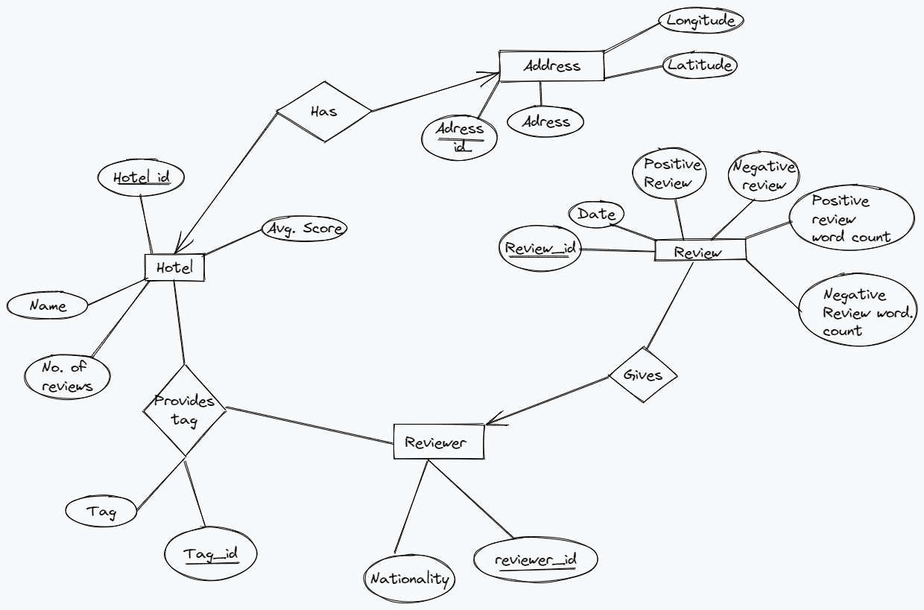
Entity Relationship Diagram

Slide 10
Database
Database description:
The data from the data set is divided into respective entities. As is visible from the ER diagram in the previous slide, there are 4 main independent entities hotel, address, Review and Reviewer. In the database, there are different tables for each of these data sets and their relevant attributes as given in the ER diagram.
The Hotel entity is an independent entity representing a unique hotel and the Address entity is also an independent entity representing a unique address for each hotel. The review entity is also an independent entity representing each unique review given by a reviewer. The reviewer entity is essentially a list of all unique countries people have given reviews from.

Slide 11
Tables
Table | fields | Number of rows
Hotel | hotel_name | 68
 | avg_score | 68
 | total_reviews | 68
 | hotel_id (primary key) | 68
 | address_id (foreign key) | 68
 | address (taken from Address using address_id) | 68
Address | hotel_address | 68
 | latitude | 68
 | longitude | 68
 | address_id (primary key) | 68

Slide 12
cont.
Table | Fields | Number of rows
Reviewer | nationality | 149
 | reviewer_id | 149
Review | date | 30,000
 | Negative_review | 30,000
 | Neg_word_count | 30,000
 | Positive_review | 30,000
 | Pos_word_count | 30,000
 | score | 30,000
 | Review_id (primary key) | 30,000
 | Hotel_id (foreign key) | 30,000
 | Reviewer_id (foreign key) | 30,000

Slide 13
cont.
Table | Attributes | Number of rows
Tag | tag | 30,000
 | tag_id (primary key) | 30,000
 | hotel_id (foreign key) | 30,000
 | reviewer_id (foreign key) | 30,000
 | hotel_name (foreign key taken using hotel_id) | 30,000

Slide 14
Functional Dependencies
Hotel (hotel_id ->(hotel_name, avg_score, total_reviews, address_id),
address_id->address)
Address(address_id->(address, latitude, longitude))
Tag(tag_id->(tag, hotel_id, reviewer_id), hotel_id->(hotel_name))
Reviewer(reviewer_id->(nationality))
Review(review_id->(date, positive_review, pos_word_count, negative_review, neg_word_count, score, hotel_id, reviewer_id))

Slide 15
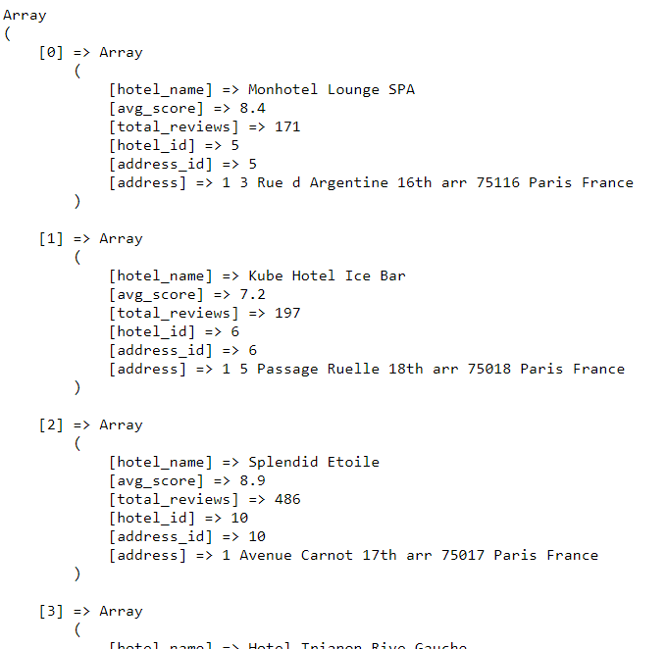
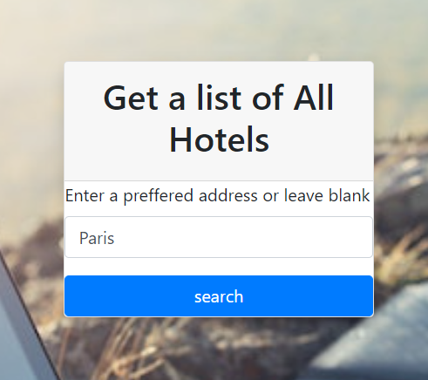
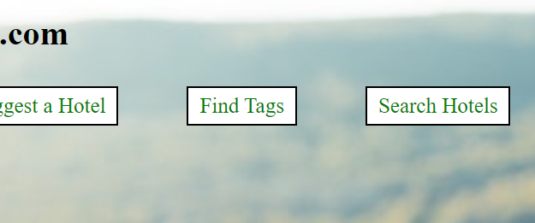
Sequence of Functionality

Slide 16

Implementation
System Software Architecture:
Database – MySQL, Server 8.0.
UI - XAMPP (PHP), HTML, CSS
The HTML file takes in the user input, passes the input to the .php file. The .php file is linked to the database in MYSQL through the new mysqli() method and passes a query to MYSQL which gets executed by the execute() method. The returned result by MYSQL is given to the .php file which then returns it back to the html file.

Slide 17
Input/Output Transition
HTML FILE INPUT/ OUTPUT
PHP file
Database in My SQL

Slide 18

Project Demonstration

Slide 19
Database Demo
This is a demo of our database. Short descriptions of the database and the contents are covered in this video.

Slide 20
Evaluation and Testing
Testing Get Hotel Information
On entering a valid name, the details of the hotel would get printed. If it’s a generic name, details of all hotels having the name will get printed and if it’s an invalid name, an appropriate error message will be displayed.
Testing Search Review
For searching reviews, try entering an invalid hotel name (like “vjfhvbshfb”), the error message displayed would be “Please enter a correct hotel name!”
On entering an invalid choice for type of review (like “wregfwgfk”), the error message displayed should be “Please enter either 'Positive', 'Negative' or 'All’!”
On entering all valid options (like “Arena” for name and “Positive” for type), then all appropriate reviews for the particular hotel will get displayed.

Slide 21
cont.
Testing Add Review,
On entering any invalid input, the UI will display an appropriate error message. After entering all valid input, insert the query. We can cross check in the database for Review by typing “select * from Review ORDER BY review_id DESC LIMIT 1;” which will give you the last row and that should be your review. You can also crosscheck the total_reviews in Hotel entity for the particular hotel and it should be update by 1.
Testing Suggest a Hotel,
On entering invalid nationality or entering a nationality from where there are no reviewers, message displayed would be “There are no good hotels liked most by the people of your nationality!”
On entering something valid like “China”, the hotels visited by people from China would be displayed in descending order of their scores and then their total reviews.

Slide 22
cont.
Testing Find Tags
For finding tags on entering an invalid hotel name, “No Hotel of this name found!” should be displayed. On entering a valid hotel name like “Arena” or “Crowne Plaza Paris R publique. ” the relevant tags should get displayed.
Testing Search Hotels
For testing search hotels, on entering an invalid address that does not exist in the database “No Hotel of this Address found!” should be displayed. On leaving the field blank, all hotels in the database will be displayed. On entering something like “Paris” all hotels in Paris will get displayed.

Slide 23
Conclusion
Database knowledge: By doing this project we gained a valuable insight in the field of database technologies and gained a basic understanding of how websites made using database technologies work. We have also understood that database technologies are essential in storing and retrieving information and I believe that working on a project like this has really helped me gain an exposure to this field.
Overcoming difficulties: By the end of the 5th week, one of our team members had decided to continue this course no further and the amount of work we still had to do suddenly increased by 33%. We were honestly terrified as to how are we going to complete this project on time but using time management we managed to complete everything. Our front end was also causing weird errors which were related to the connection between XAMPP server and MYSQL established in the computer. We had to troubleshoot through a lot of online debugging tactics to finally be able to establish a connection and getting things ready. We also had other assignments which we successfully completed as well so we learnt how to overcome difficulties while doing this project.
Analysis and behavioral patterns: As a part of our project, we took negative and positive reviews from people of different nationality. Through this approach, we can analyze the preferences and the behavioral patterns of the population of that country in general. Using concepts of AI and ML we can extrapolate the data on a larger scale and find out patterns which could prove to be helpful in the hospitality industry.
Front End– This was the first time I have implemented a user interface to get input from the user and put the information in the database. I learnt something new by discovering php, HTML and CSS.

Slide 24
cont.
Group Work: Through this project we have also learnt how to get the project done and not rely on anybody while doing the project. We had a moment where one of our team members decided to drop out, but still we managed to get everything done on time. Thus, we have learnt time management skills through this project as well. Overall, it was a really good learning experience for us.

Slide 25
THANK YOU!!!

